Slide 1

Controlling Volume with Hand Gestures using a Webcam
Milestone 2:(Weeks 3–4)

Slide 2
Tasks:
Gesture Recognition and Distance Measurement Module
The distance between thumb and index finger tips will be calculated.
Gestures will be classified based on this distance to represent control actions.

Slide 3
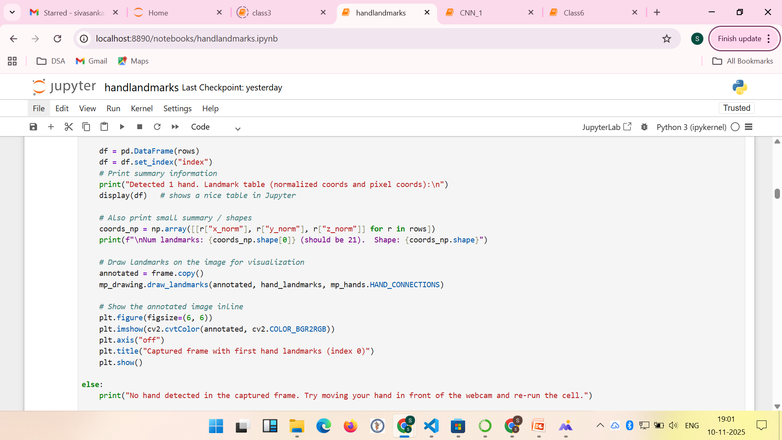
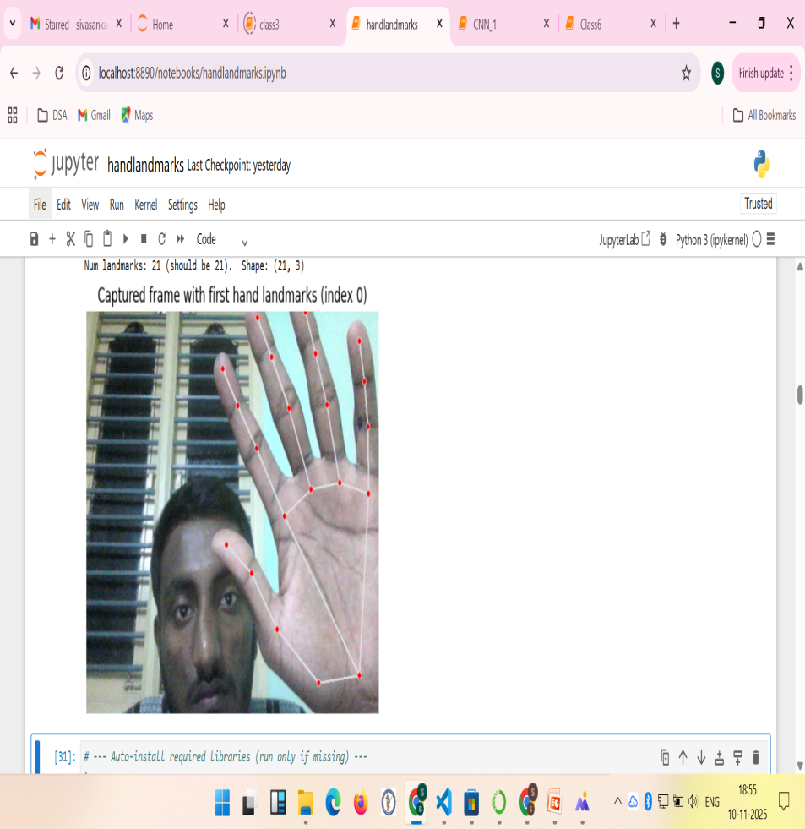

Slide 4
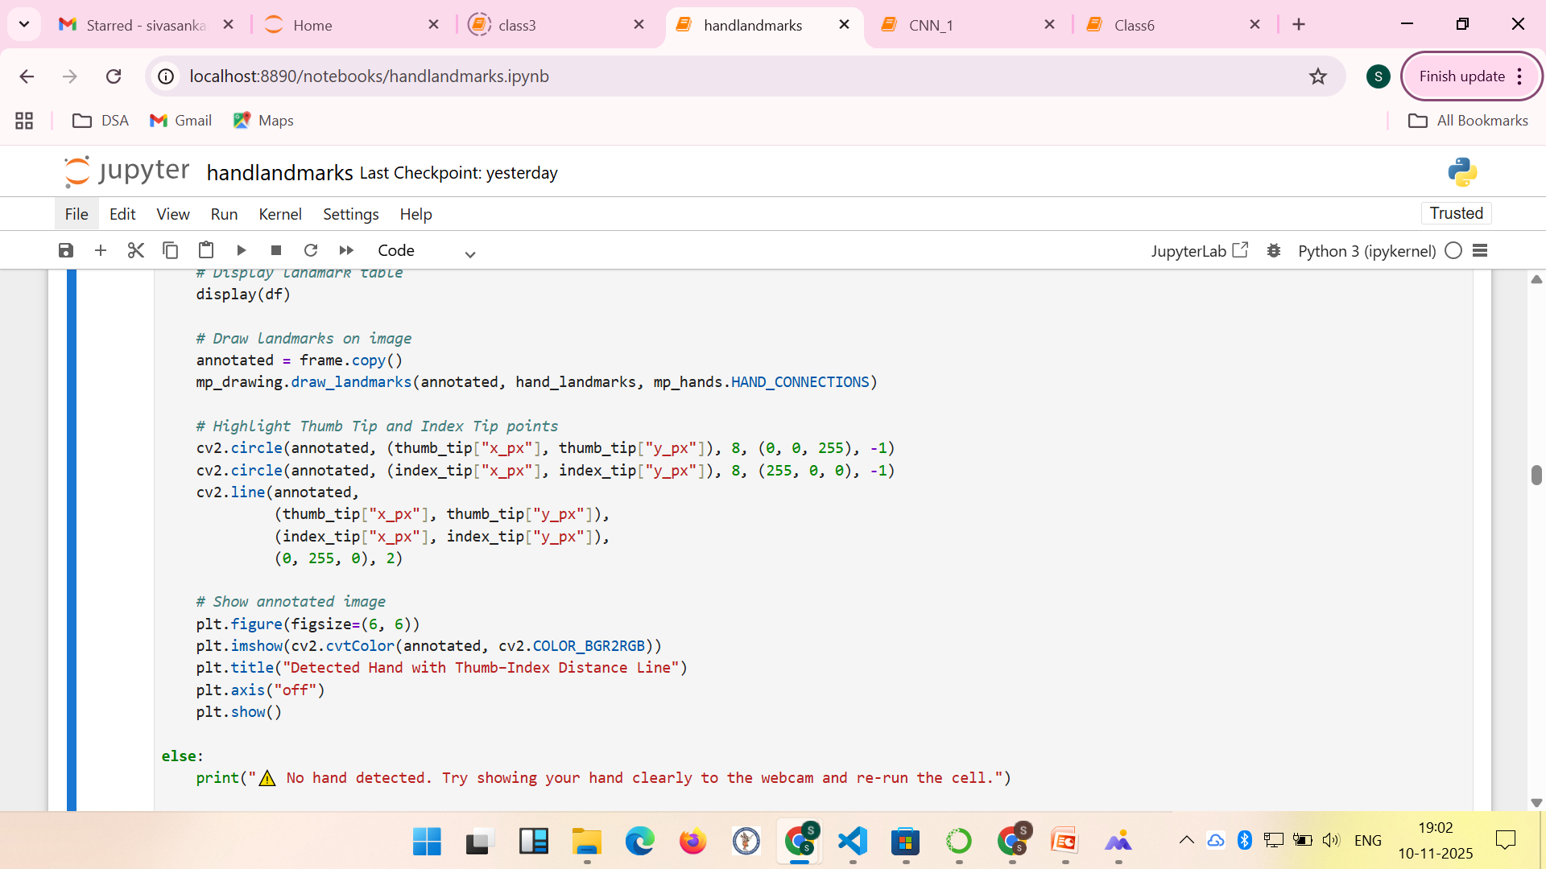
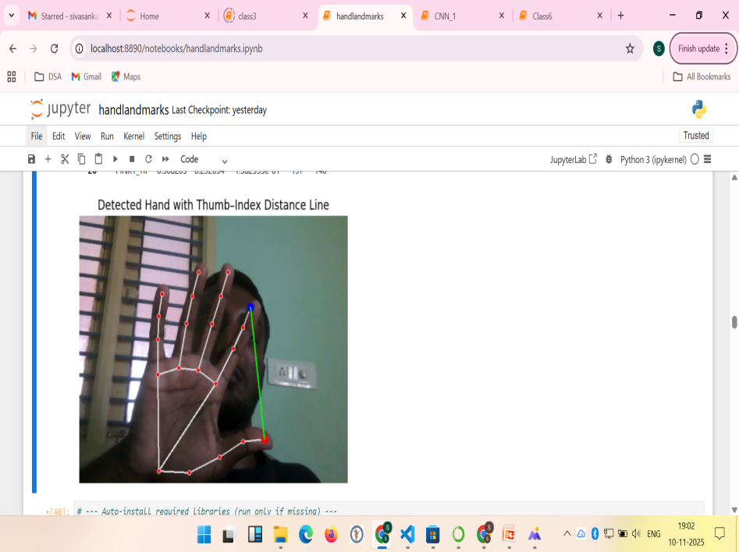

Slide 5
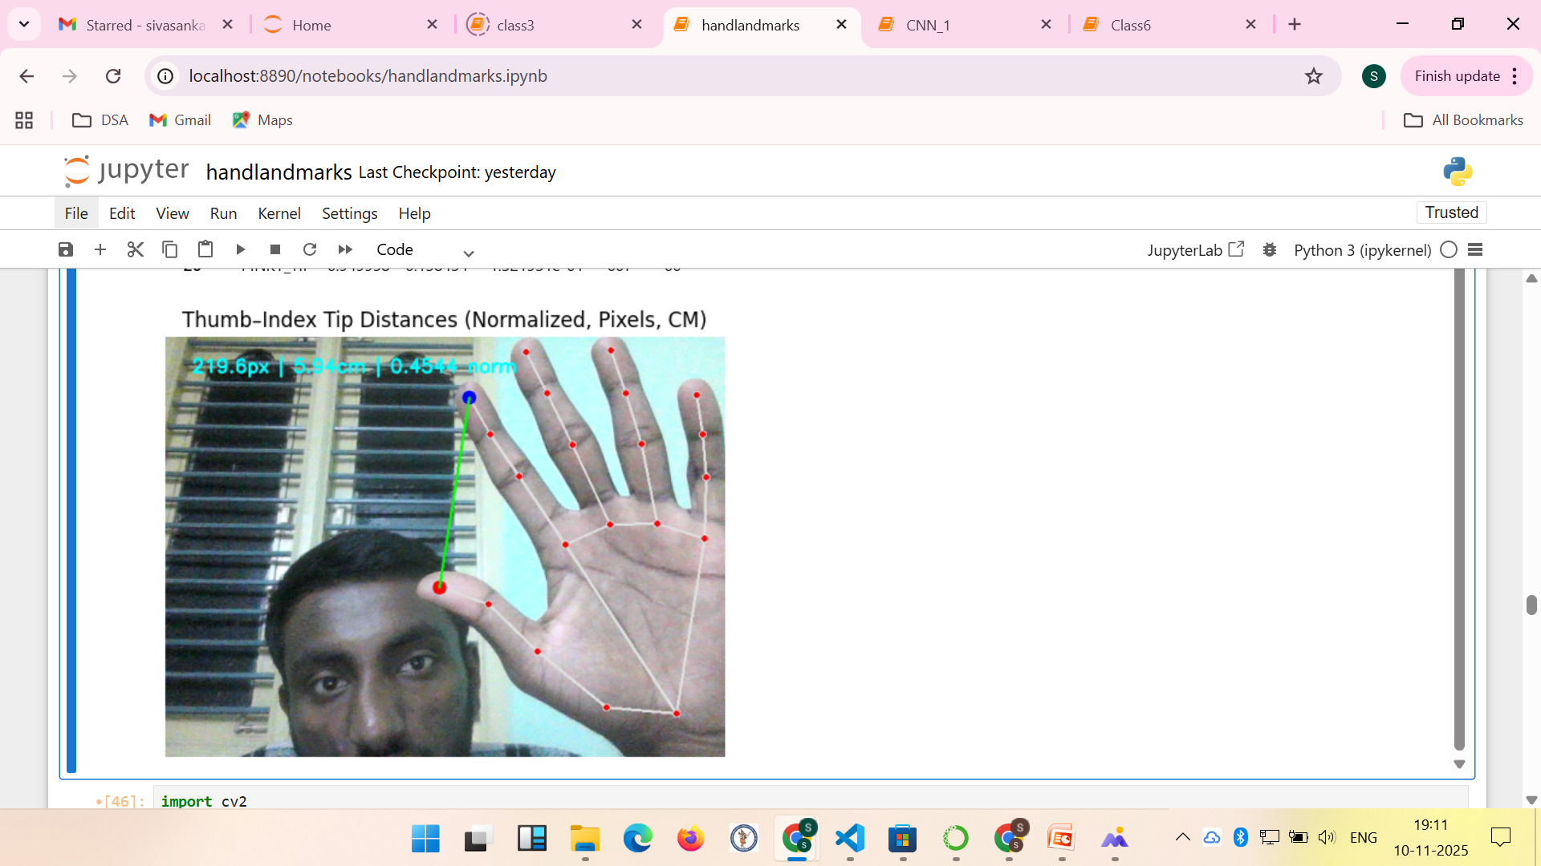

Slide 6
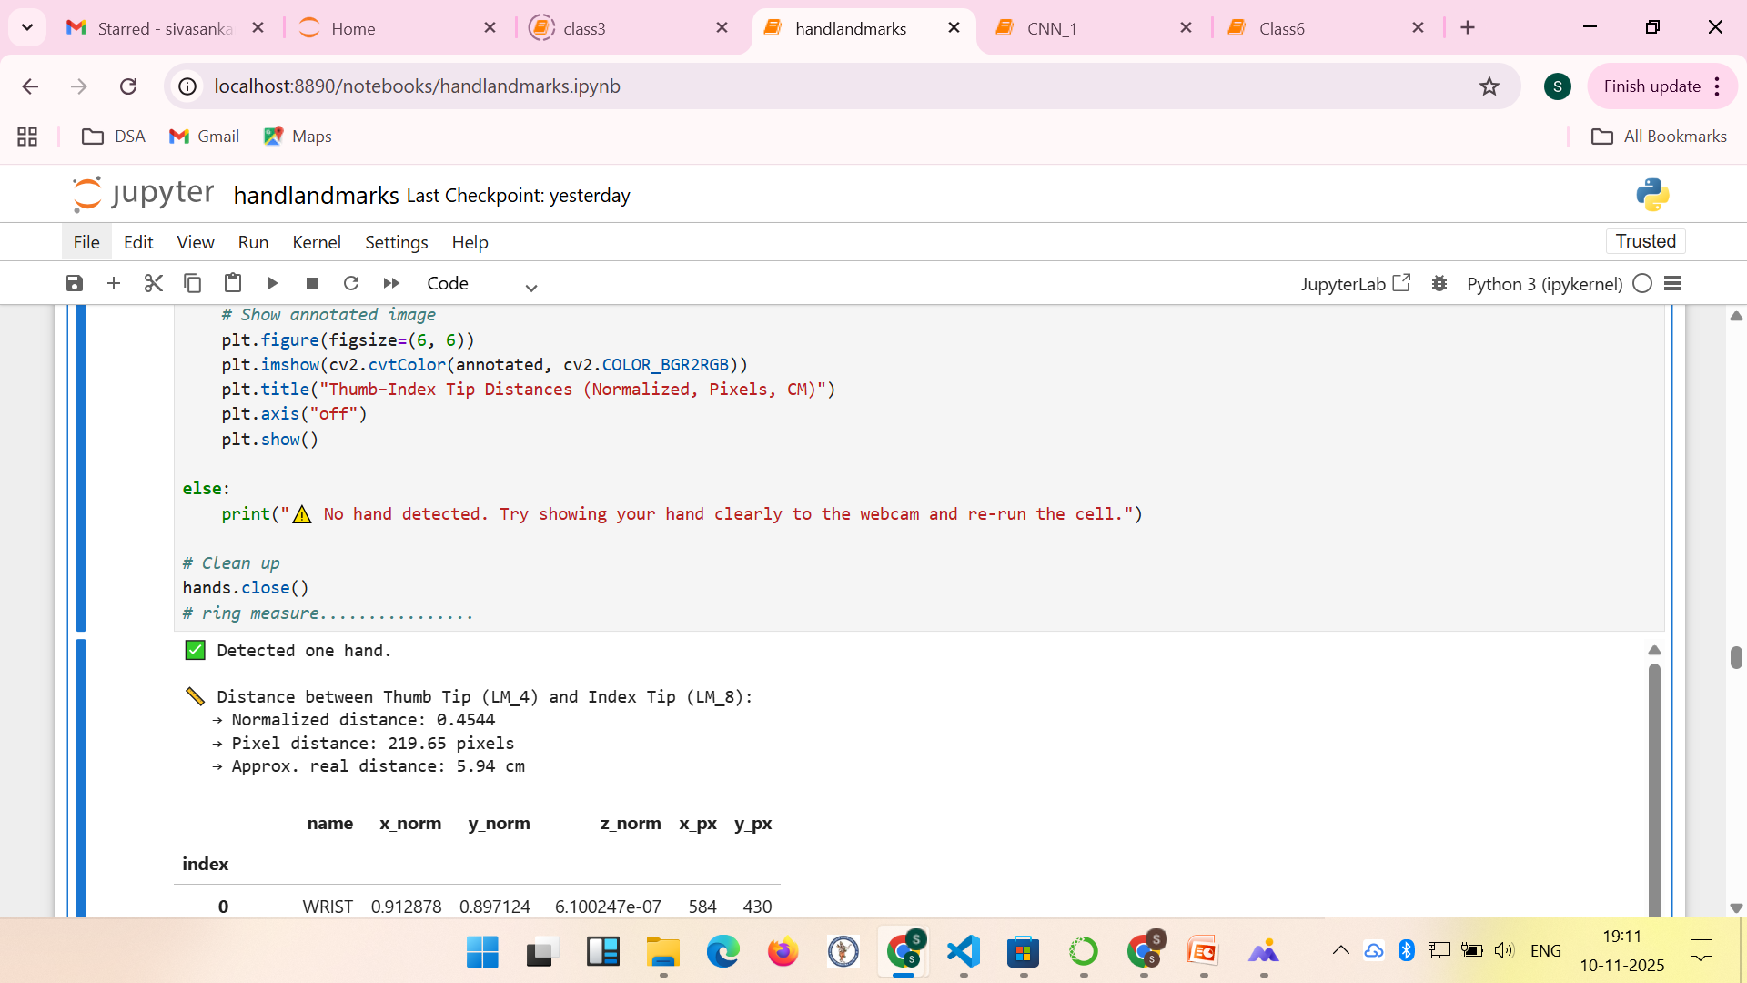

Slide 7
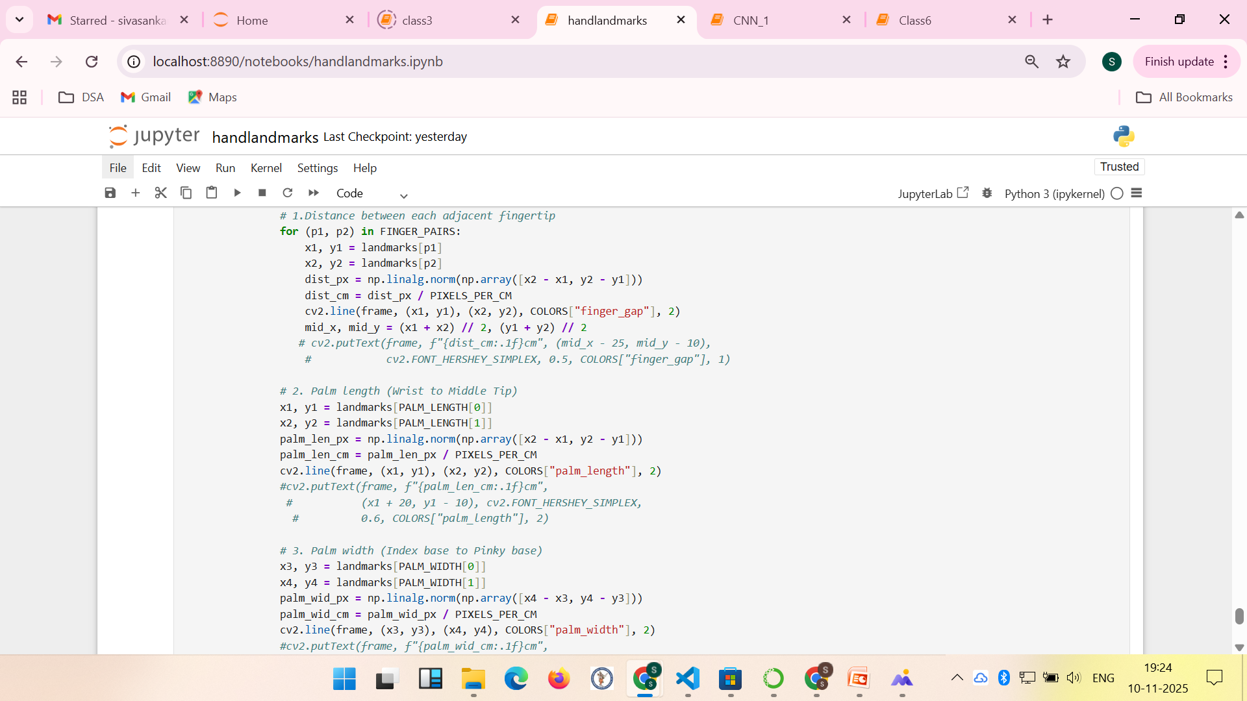

Slide 8
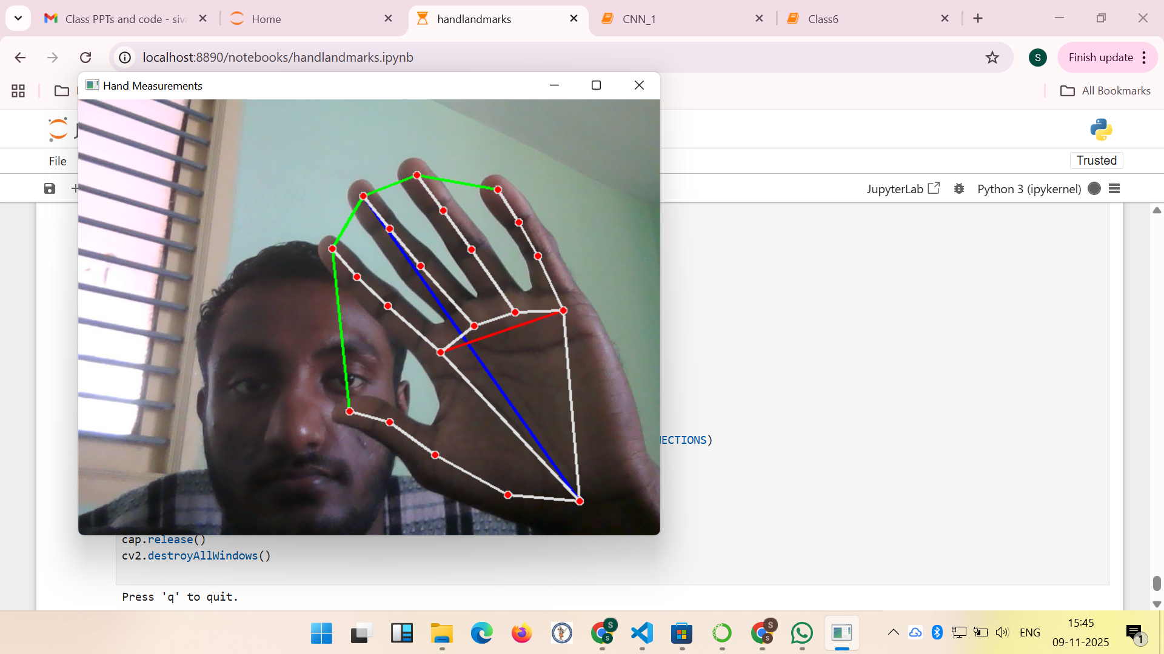
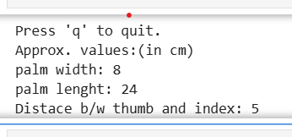

Slide 9
Front-End Design:
HTML5 – Structure of the interface
CSS3 – Glassmorphism UI with animations
JavaScript – Dynamic content updates and camera control
Bootstrap (Optional) – For responsive layout if needed

Slide 10
Back-End:
Python (v3.x) – Core programming language
OpenCV (cv2) – Real-time camera access and image processing
MediaPipe – Hand detection and landmark extraction

Slide 11
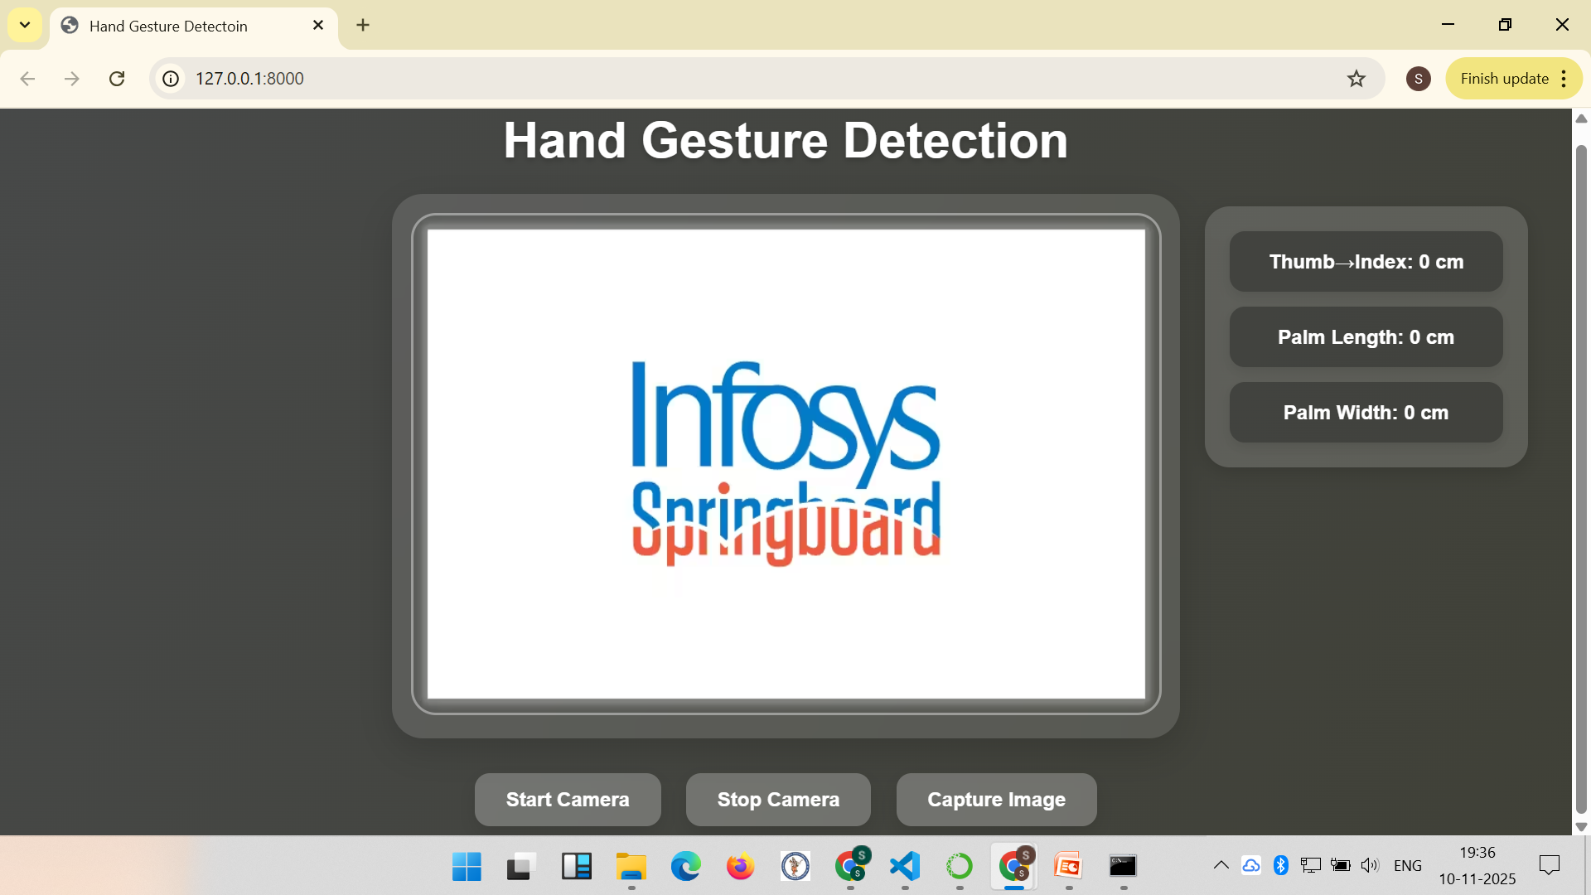
Sample Design:

Slide 12
Practical Implemtaion.
Functionality……………..Explaination…..

Slide 13
Ending..
Thank You……..

